Slide 1
Cromarty Youth Café Action Packed Summer Programme 2022

Slide 2
Staff, Young Saltire Volunteers & Highlife Highland Leaders
I would like to say a HUGE thank you to all the young volunteers / leaders who turned up everyday of their summer holidays to deliver activity to other young people.
The biggest thank you goes to Wanda for her invaluable time, support and knowledge for supporting to run this programme and for finding the funding all year round for all our young people to be able to enjoy attending Youth Café and holiday programme activities.

Slide 3
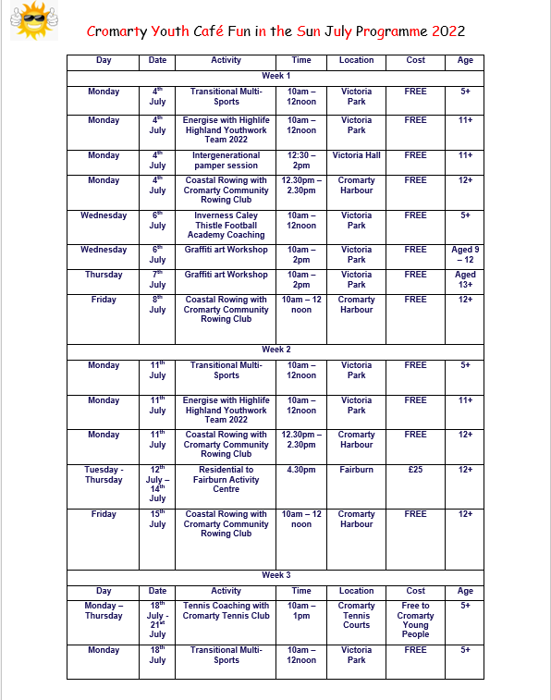
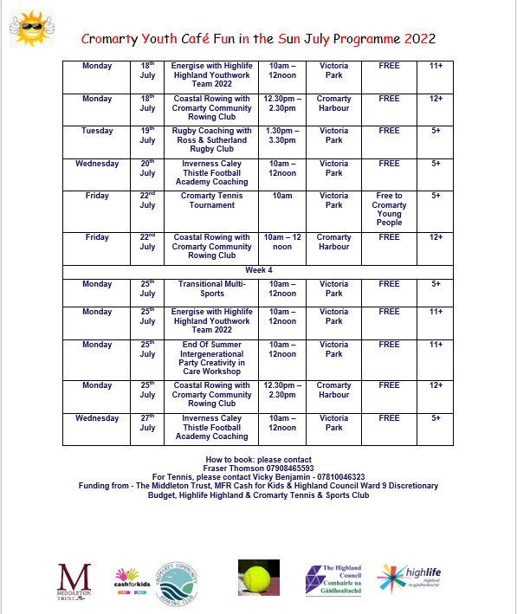

Slide 4
Numbers:
Programmed Activities: 49
Number of participants: 695
Learning Hours: 1700
At every activity young people volunteered their time.

Slide 5
The Food
With the donation from Cfine, & Funding from, The Black Isle Wards Discretionary Budget, The Scottish Government, MFR Cash for Kids & Food +, we have been able to deliver an action packed exciting Summer programme, Breakfast, Lunch, Dinner snacks & Picnics were provided at every activity daily.

Slide 6
No Holiday Hunger Teens / Tots/ Grandparents Spectators/ Visitors/ Volunteers / Recycled Teenagers Ages from the Cradle to the Grave and everyone in between age is but a number
During the summer holidays young people have been offered a deluxe buffet at every activity,
The buffets contains,
Selection of different breakfast Cereals
Fresh fruit platters / Kebabs and Food
Various Hot meals, Macaroni, Chicken Curry, Hot Dogs, Fresh Home-Made Pizza’s with a range of topping’s, Homemade burgers, Quiches, Grilled Halloumi , Pasta Bakes, Nacho’s with a range of dips. Cheese Boards
Selection of Sandwiches bagels, baguettes, wraps toasties panni's ,
Crisps
Deluxe Homemade Waffles with a range of toppings,
Cup Cakes , Banana Muffins home made brownies, Fresh Scones. Fruity Flapjack, range of traybakes.
Sausage Rolls, Quiches
Homemade Breaded Chicken Bites and plant-based chicken goujons
Ice Cream or Ice Pole.

Slide 7
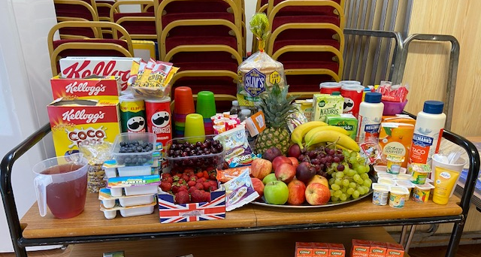
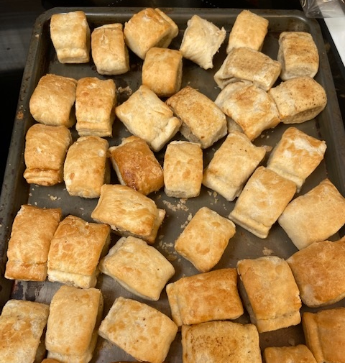
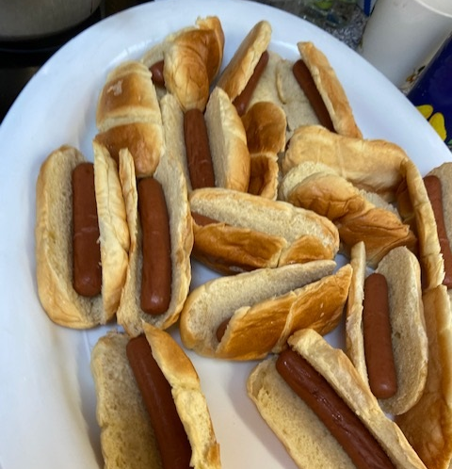
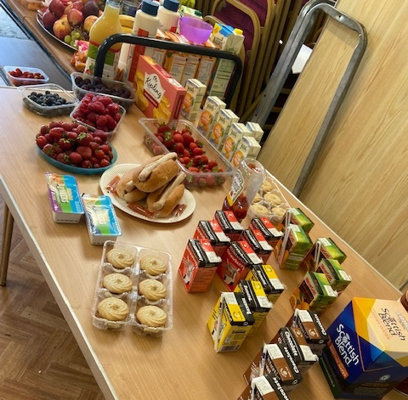

Slide 8
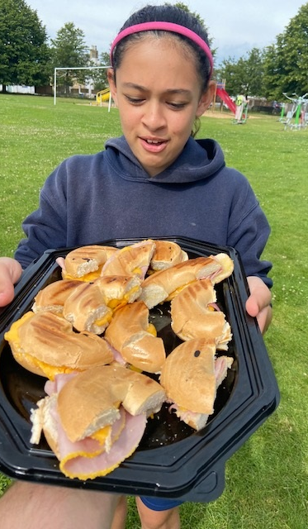
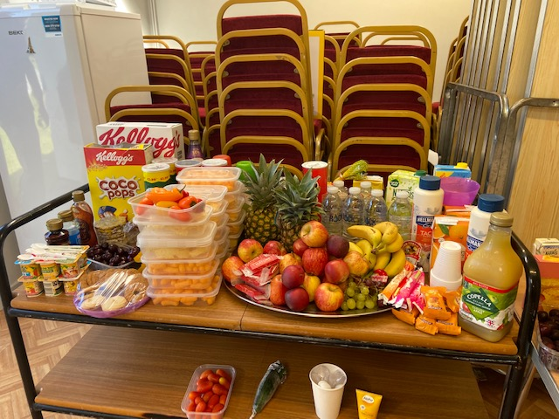
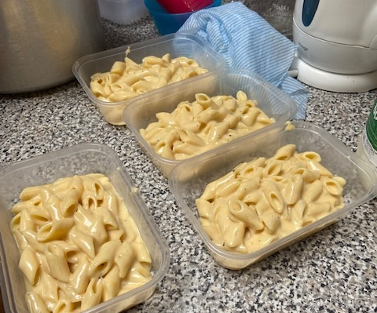
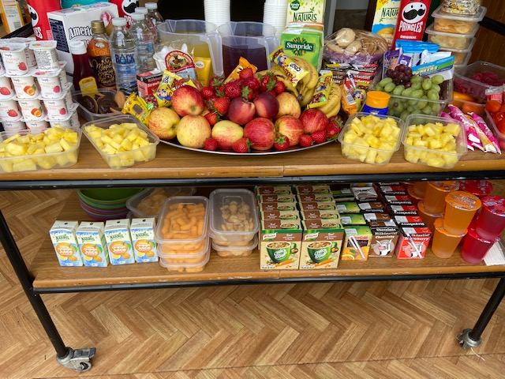
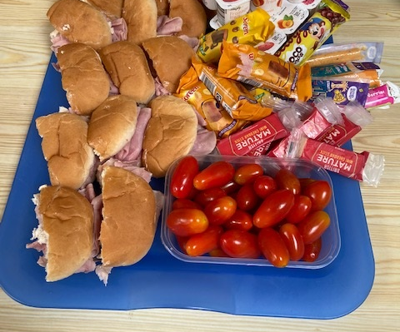

Slide 9
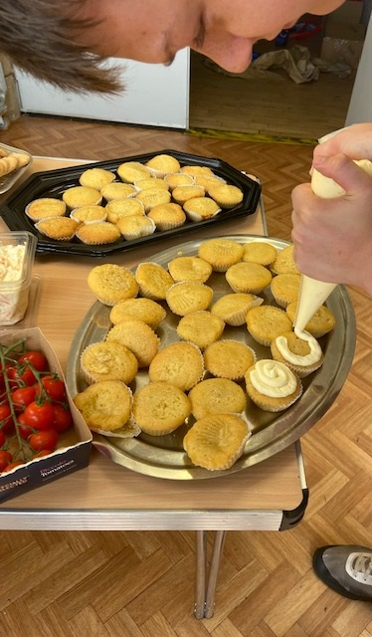
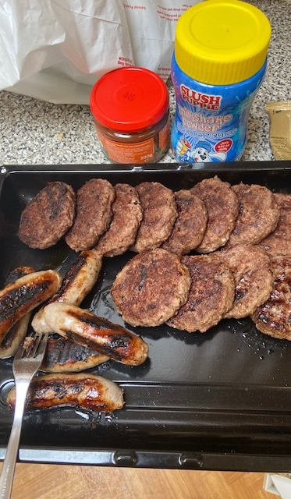
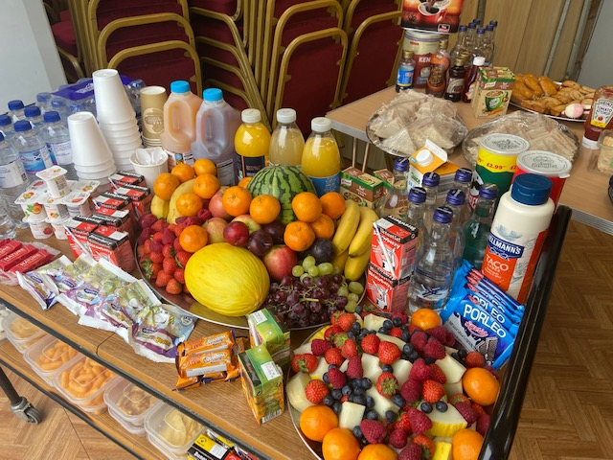
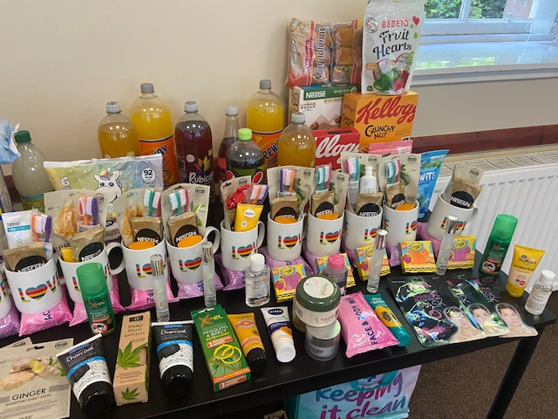

Slide 10
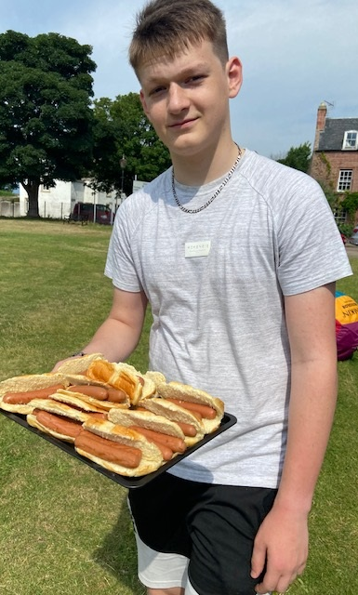
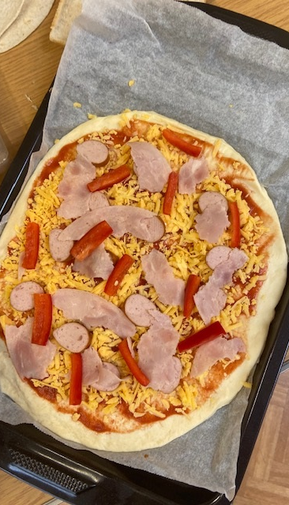
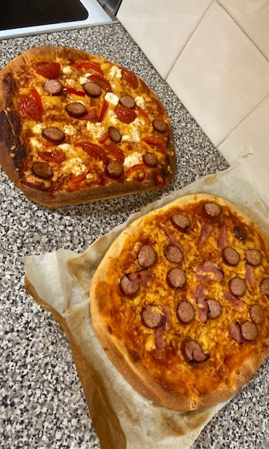

Slide 11
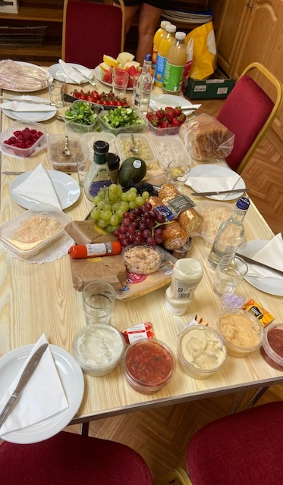
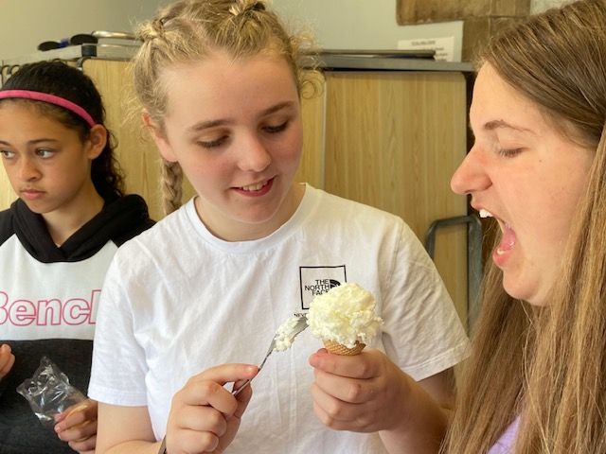
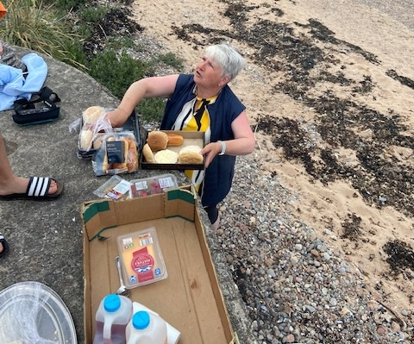
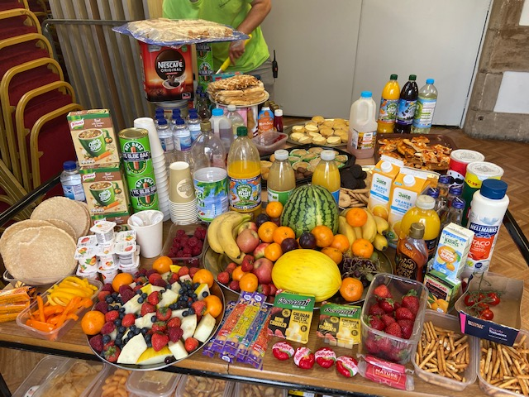
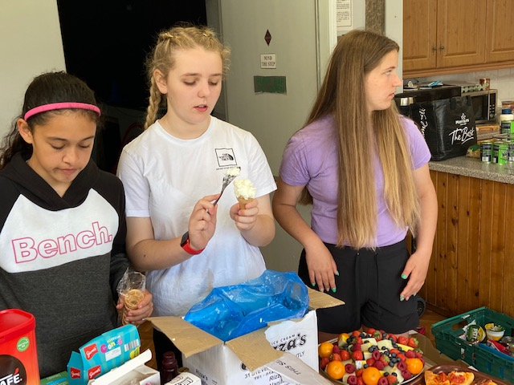

Slide 12
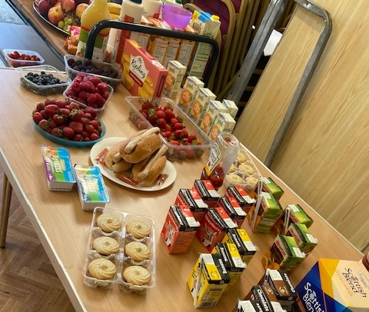
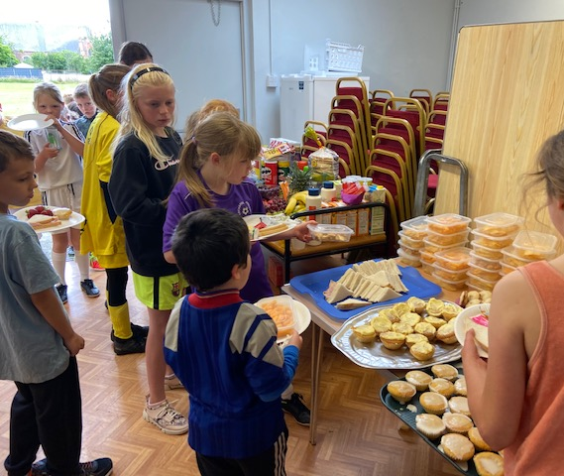
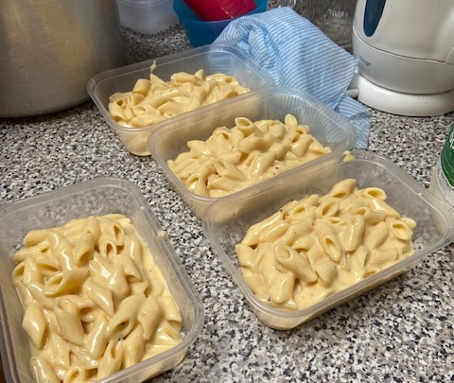
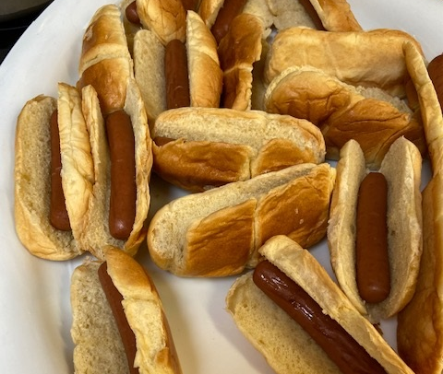
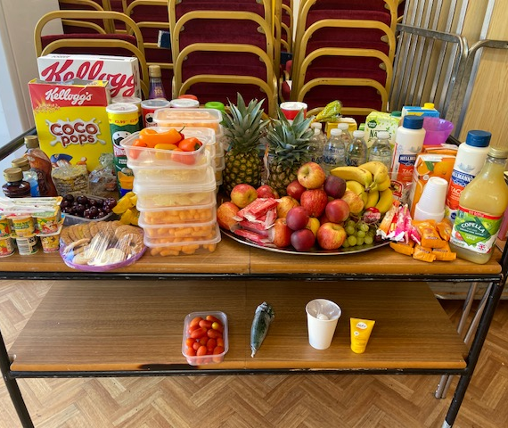
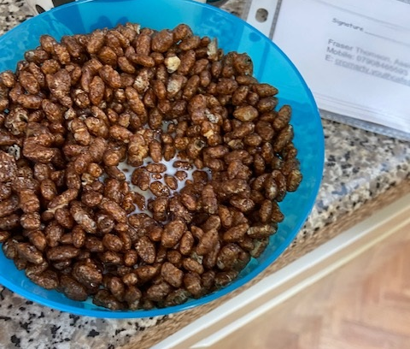

Slide 13
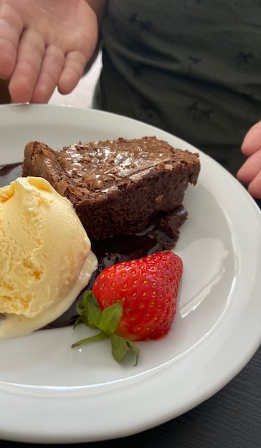
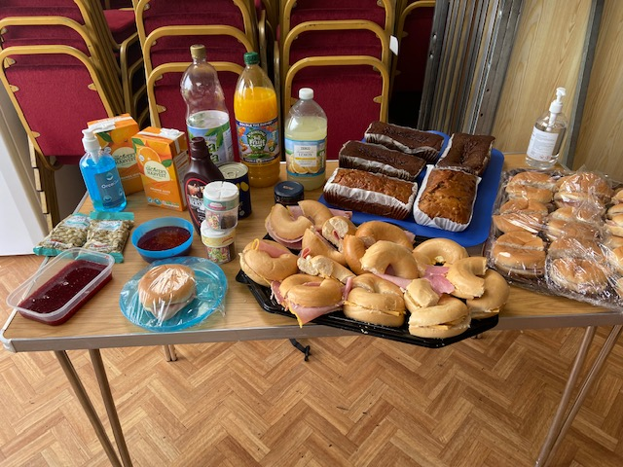
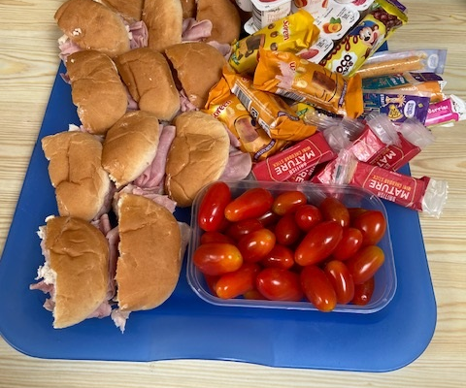
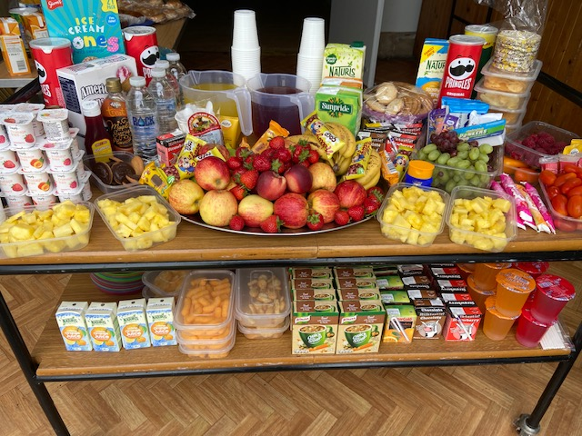
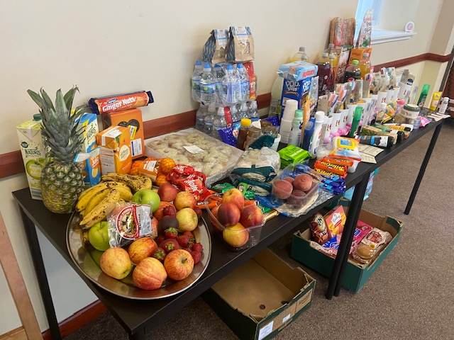

Slide 14
Food Safety at Work Level 1, 2 & 3
With a little bit of funding from the Scottish Government, young people have been able to take part in Food Hygiene courses at various different levels.( Thank you Alan for finding this funding)
Young people have been working their way through the courses, and have been learning about good hygiene, and correct ways to store food.
This will enable young people to cookwell, Bakewell , Eatwell and in turn Livewell.

Slide 15
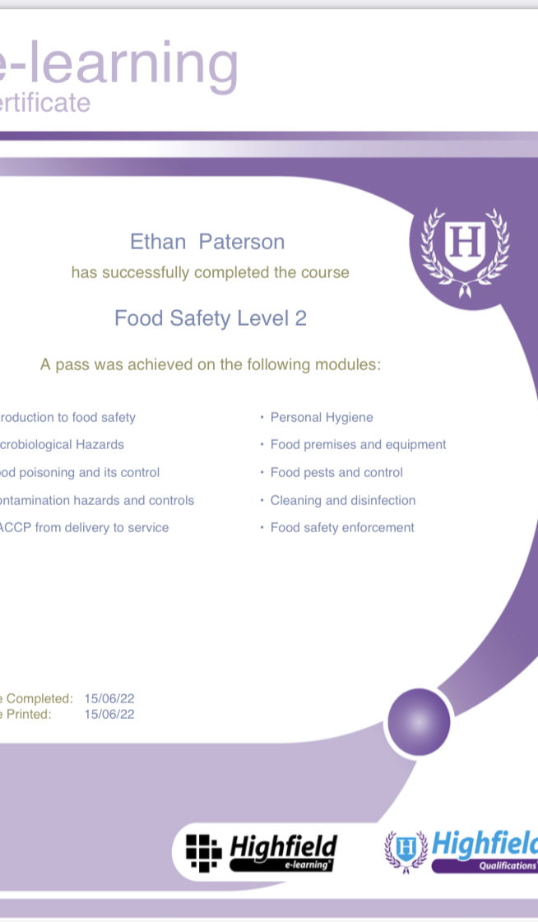
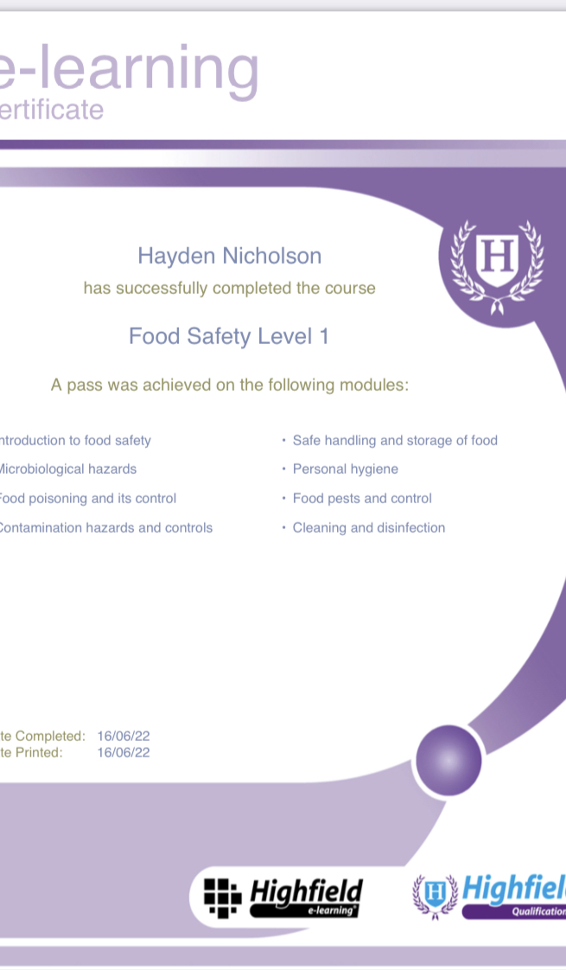

Slide 16
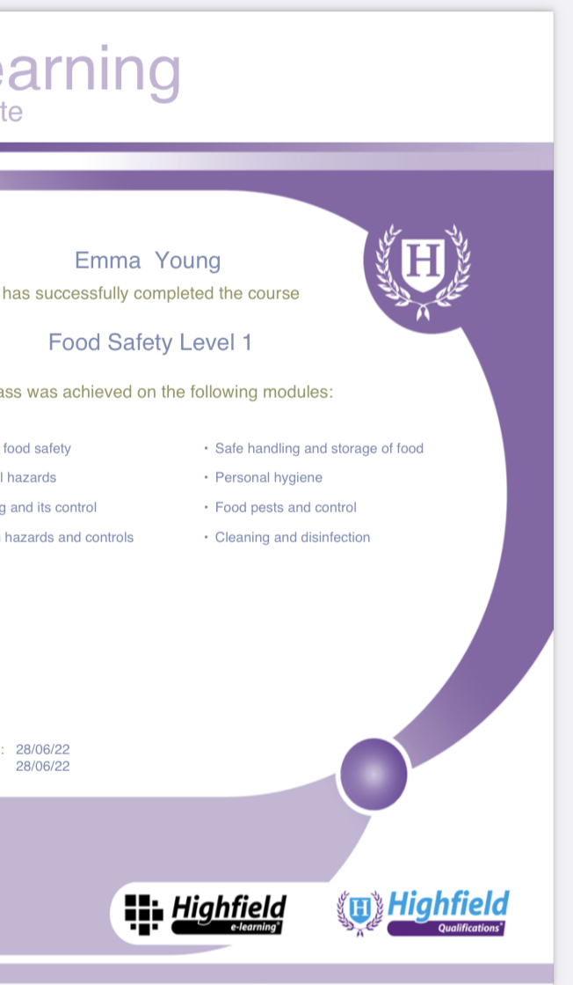
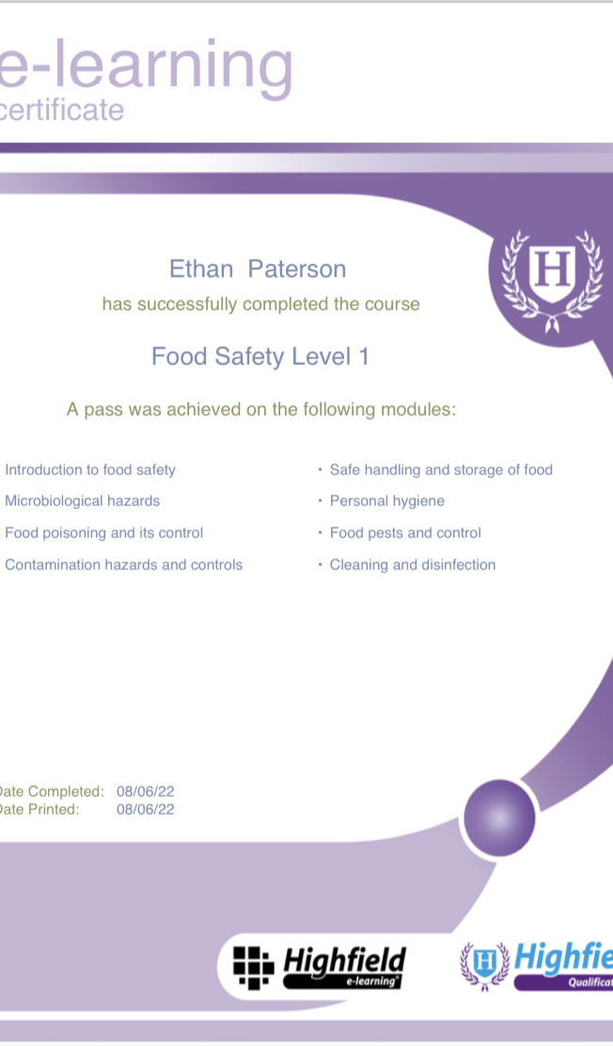
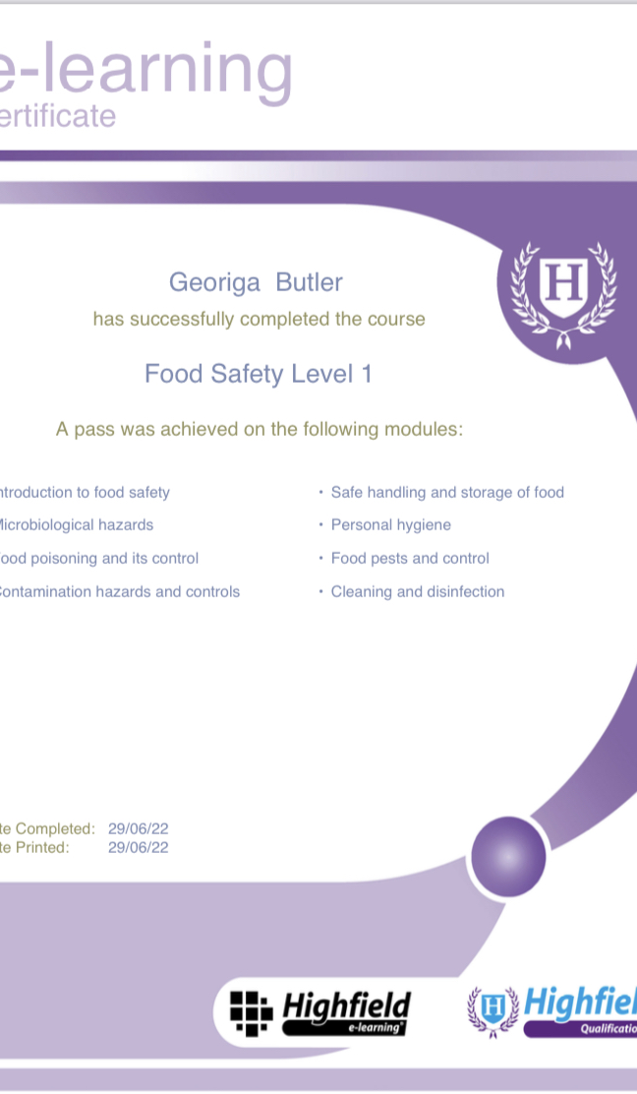

Slide 17
Well Being pack Door Step Deliveries
Vulnerable families & members of the community were given food parcels dropped onto their door steps:
Each pack contained:
Pot Noodle
Pasta & Sauce
Cuppa Soup
Fresh veg
Pringles ,
Fresh home made soup
Various different cooking sauces
Fruit Cocktail
Crisps
A LOVE Mug
Tooth Brush, & Tooth Paste,
Pop Tarts
Facial Mask & Hand Cream
Selection of Hot Bagels
Selection of Fresh Home Baking
Shampoo, Condiationer

Slide 18
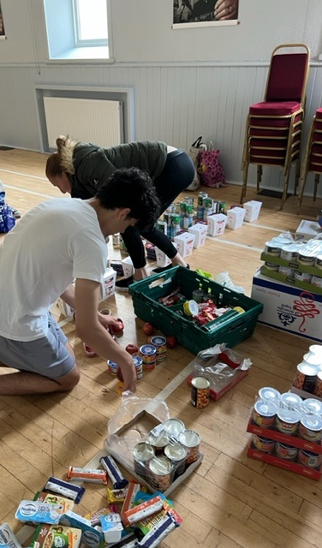
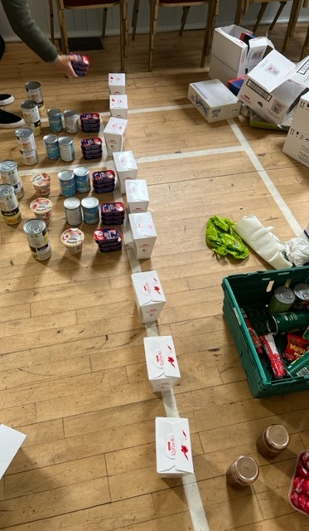
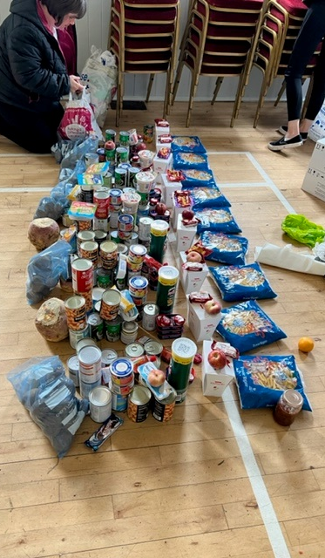

Slide 19
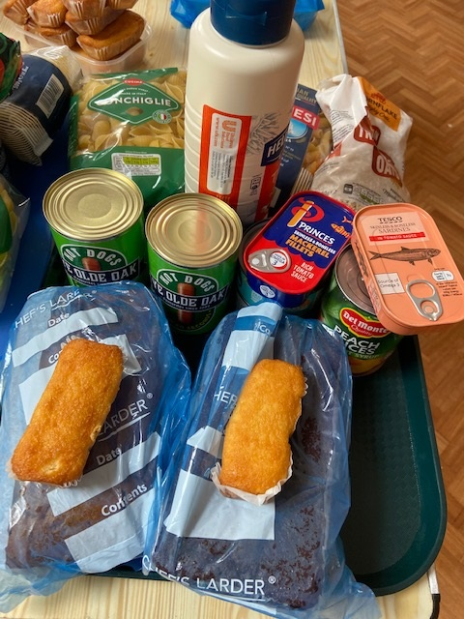
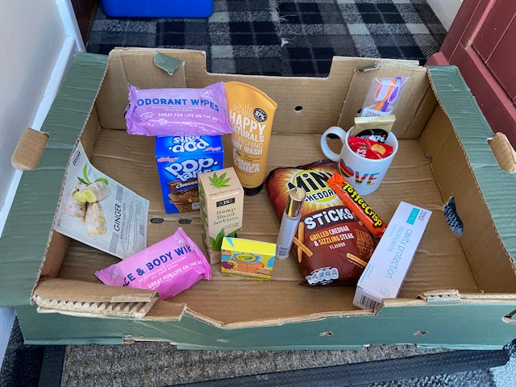

Slide 20
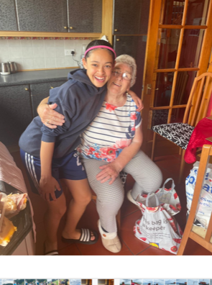

Slide 21
Transitional Multi Sports & Energise with HLH
Multi-Sports sessions led by HLH Young Leaders.
Young people were offered the opportunity to take part in a range of different games,
Young people were able to meet our new Active Schools Coordinator John Mann

Slide 22
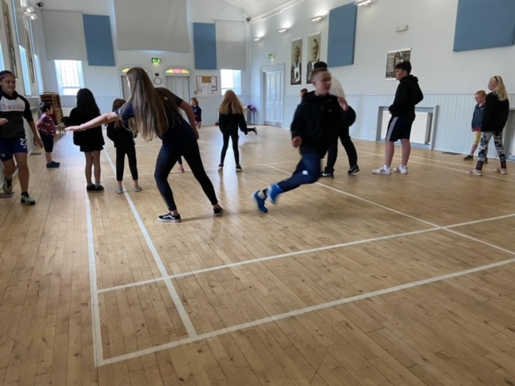
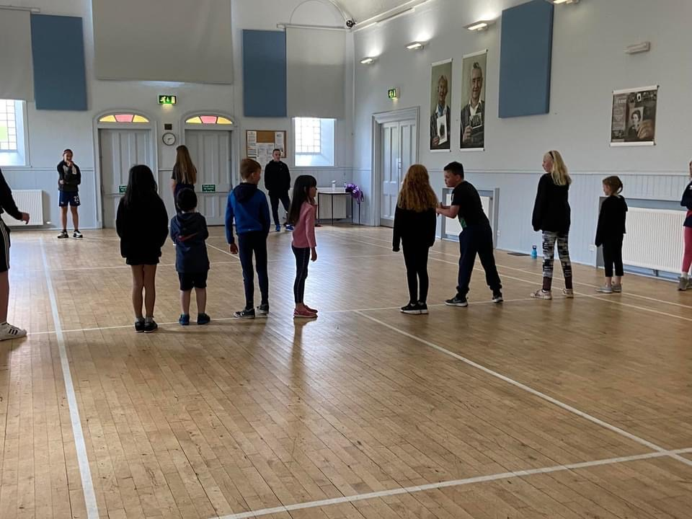
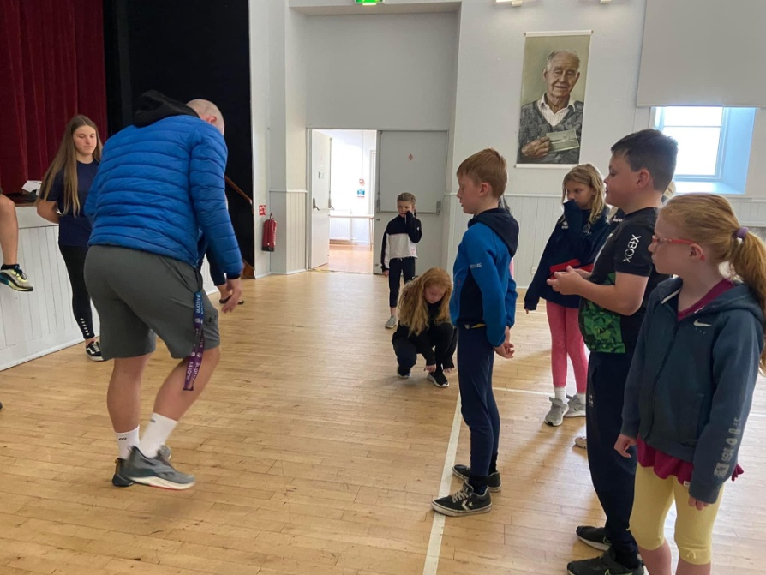

Slide 23
Graffiti Art Workshop’s
Two great days with Tommy Keyes artist 🧑‍🎨 & Cromarty Arts Trust working in partnership with Cromarty Youth Cafe and our budding young Artists get yourselves along to the Victoria Hall park and see the Amazing and Creative Graffiti Art 🖼 Boards an Free Outdoor Gallery to brighten your days viewing
Young people learned how to design on a piece on paper, the various style options, paint control techniques for outline and fill in, colour choice and the various effects such as highlights, drop shadows and 3D by using Spray Paint,
Young People loved the sessions

Slide 24
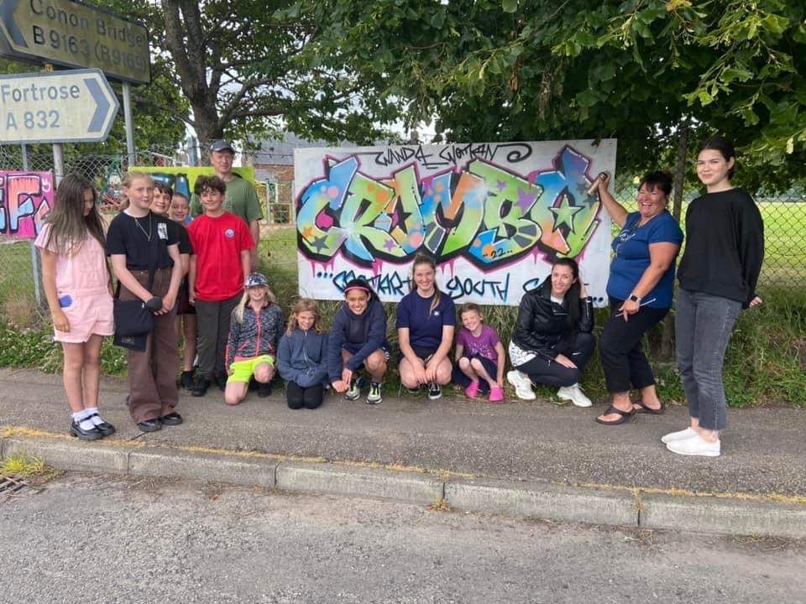

Slide 25
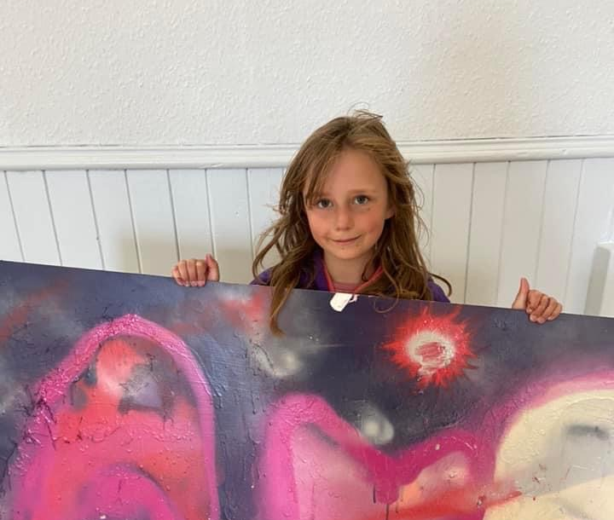

Slide 27
Football Academy with Inverness Caley Thistle
This football Academy session was well attended,
The young people learned lots of new skills, Passing , Dribbling , Target practice and mini Games.

Slide 29
Residential to Fairburn
We enjoyed a residential to Fairburn Activity Centre.
This was the highlight of the Summer programme.
Young people took part in, Crate Stacking, Canoeing, Bubble Football, Archery, Football, Raft Building, Orienteering, Bushcraft.
Young people created a TikTok – video below.

Slide 30
Evaluation of Fairburn
Food was amazing
WE had the time of our lives
We want to come back for longer
Accommodation was great
Amazing instructors
Great Time
Staff were brilliant

Slide 31
Platon Finding Robbie on Snap maps

Slide 34
Creativity in care Workshop
Great to have Karrie & Chris from Creativity in Care back to continue our sessions talking about what lockdown was like, what did you miss, what did you do?
Lots of chats and conversations whilst taking part in arts and crafts making Hand Made Puppets great to see the puppets from the Lebanon
Huge thank you to our HLH Young leaders and our Youth and adult volunteers for working with Wanda to create a Super Deluxe Buffet 🍎🍉🍒🥑🥥🍏
Huge thank you to Michelle for her Triple chocolate brownies mmm Mary for The Best Pancakes 🥞 and homemade jam Oskar and Matilda for white and milk chocolate 🍫 muffins
Massive thank you to Ethan for baking for 7 hours on Sunday and working all Mon also
Roast Beef 🥩 and Horseradish sandwiches Chicken snd Beetroot Chutney sandwiches 🥪 , Sizzling Sausage Rolls
Egg Mayo With baby toms
Gingerbread with fiery ginger, Earl Grey T loaves
Chocolate Cake for John, Cherry 🍒: Plain Scones
Glace Cherry Loaf Sticky Lemon 🍋 Fancies
All Butter Shortbread
Mini Fruit Strawberry 🍓 Pavlovas
Cheese and Biscuits 🍪
Food 🍱 boxes delivered

Slide 36
Tennis coaching
In Partnership with Cromarty Tennis & Sports Club there was a week long Tennis Camp held for young people,
Each session young people were improving on there tennis skills & drills
Huge thanks to Vicky for organise the tennis coaching week.
Vicky also organised The Crombeldon Tournament

Slide 38
Rugby Coaching with John Mann
Young people were able to take part in Rugby coaching with John Mann.
Young people learnt the basic of rugby, how to throw and catch the ball,
How to pass and then the session ended with mini games

Slide 40
Youth Rowing
Youth Rowing happens for 6 hours each week
Young people were practising on there timing and form for rowing, Learning about, Wind, Weather, Tides enabling young people to be come safe at sea
Young people took part in Avoch Regatta. Gaining medals.
Cromarty Community Rowing Club Won the Overall trophy at Avoch Regatta.

Slide 43
1-1’s
During 1-1s young people have told us:
There are more anxious now than ever before
Young people are feeling lonely,
Young people are anxious and stressed about their next steps and, with young people going to different destinations.
Wanda’s has been supporting one of the Ukrainian Refugee families to get into employment, supported with housing application,
We support a number of Care experienced young people (also referred to as looked-after young people) at our activities each week
Over the last year, 8 children that we work with have lost a parent.

Slide 44
Supporting Families
Over the summer holidays we supported families with either Tesco Shopping vouchers or vouchers the post office for electric,
There funds came from MFR Summer Emergency Grant’s

Slide 45
Farewell
At the end of July, we said Farewell to John Munro,
John was a huge asset to Cromarty youth Café,
Young People created a memory frame for John
John has now moved onto full-time employment at Raigmore Hospital.

